Slide 1
AIMS Redesign Subcommittee
Aug 5th, 2024
Full-Committee Meeting

Slide 2
Agenda
Recap
2024-2025 Template
Graduation Rate Formula
Wording Changes
Census Date Discussion
PDP Overlap/Next Steps

Slide 3
Recap
2024-2025 Template
Graduation Rate
Wording Changes
Census Date
PDP Overlap
July Meeting Recap
Changes to distance learning tab and rename to “Learning Modalities”
Will add table asking about “Student Employment”
Add items asking about internet connectivity
Add section on International Students

Slide 4
Recap
2024-2025 Template
Graduation Rate
Wording Changes
Census Date
PDP Overlap
2024-2025 AIMS Cycle
Remove sections the committee has agreed to cut for 2024-2025?
Pre-College Prep, HS Type, On/Near Reservation Tables – First Time Student/General Student Pop
Academic Competitiveness Grant – Financial Resources
Library Improvements/Acquisitions
Academic Core Tab
Distance TO TCU, Distance BY TCU, # of Courses Offered, # of Faculty Teaching – Distance Learning
COVID-19 Supplement/Current Student Costs – Fall Survey

Slide 5
Recap
2024-2025 Template
Graduation Rate
Wording Changes
Census Date
PDP Overlap
Graduation Rate
Exclude Transfer Outs in Denominator?
Report one % with denominator one without?
Current Formula for AY 2023-2024 Annual Report
Proposed addition for AY 2023-2024 Annual Report
2yr Graduation Rate:
4yr Graduation Rate:
Fall 2021 Cohort Graduates
Fall 2021 Cohort - Exclusions
Fall 2018 Cohort Graduates
Fall 2018 Cohort - Exclusions
Includes Transfer-Outs
2yr Graduation Rate:
4yr Graduation Rate:
Fall 2021 Cohort Graduates
Fall 2021 Cohort – Exclusions – Transfer Outs
Fall 2018 Cohort Graduates
Fall 2018 Cohort – Exclusions – Transfer Outs
Includes Transfer-Outs

Slide 6
Recap
2024-2025 Template
Graduation Rate
Wording Changes
Census Date
PDP Overlap
Graduation Rate
Which would be the more accurate story of your institution?
Do both tell equally important but different stories?
Fall 2021 has a cohort of 100 students (including transfer-ins). 50 of those students transferred out before graduating, but the remaining 50 students all graduated.
Includes Transfer-Outs
50
(Graduated)
50
(100: Cohort Size – 50: Transfer Outs)
100%
Graduation Rate
Excludes Transfer-Outs
50
(Graduated)
100
(Cohort Size)
50%
Graduation Rate

Slide 7
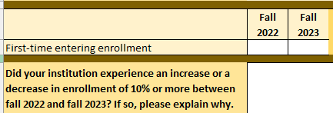
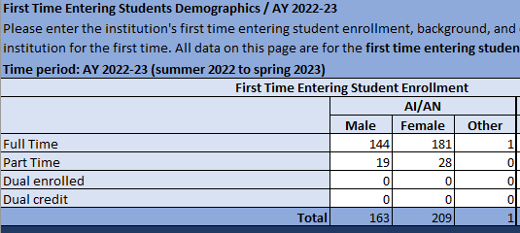
Wording Changes
Annual: First Time Entering -> First Time Ever in College
Fall/Annual: First Time Entering -> New to Institution
Recap
2024-2025 Template
Graduation Rate
Wording Changes
Census Date
PDP Overlap

Slide 8
Wording Changes
Annual: # of Courses in which students enrolled/completed -> Total Course Enrollment/Total Successful completers
Recap
2024-2025 Template
Graduation Rate
Wording Changes
Census Date
PDP Overlap

Slide 9
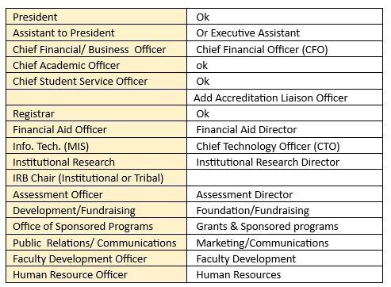
Wording Changes
Current Administration: Suggested updated titles
Recap
2024-2025 Template
Graduation Rate
Wording Changes
Census Date
PDP Overlap

Slide 10
Wording Changes
Retention, Graduation, & Persistence: Combine “Withdrew or Stopped Out” and “Other Exclusions” into “Students with Allowable Exclusions”
“Withdrew or Stopped Out” does not specify why they stopped out and is not used in the calculation in first year retention rates.
Recap
2024-2025 Template
Graduation Rate
Wording Changes
Census Date
PDP Overlap

Slide 11
Freeze/Census Date
Recap
2024-2025 Template
Graduation Rate
Wording Changes
Census Date
PDP Overlap
Previous Discussion:
Why are we collecting this data?
Can we just collect in the spring?
What truth do we want to tell?
Third week of the semester?
End of the semester?
Reasons to use frozen data:
Consistency
Frozen data ensures a consistent story across TCUs.
Decisions made to increase consistency within and across TCUs.
Data book
First Time Student data period changed to match General Student Population data
Identifying which data should be duplicated vs. unduplicated
Allows for reference point for us to confirm AIMS data
Efficiency
Data comes in simultaneously across TCUs

Slide 12
Recap
2024-2025 Template
Graduation Rate
Wording Changes
Census Date
PDP Overlap
PDP Overlap Update
New Data Analyst!
The Student Success Research Team has hired Michelle Bianco
Possess extensive PDP knowledge
Will review the overlaps between the PDP and AIMS
Next Steps in PDP overlap process:
There will be a brief break in meetings during Michelle’s review and to send out AIMS Redesign Survey.
We will next meet to review Michelle’s findings and review AIMS Survey Responses

Slide 13
Anything Else?

